Slide 1

普适计算-论文报告
2018/10/ 程书意

Slide 2
01
论文简介

Slide 3
论文简介
Detecting State Changes of Indoor Everyday Objects using Wi-Fi Channel State Information
1. 作者：来自Osaka大学
2. 分类：WiFi Sensing

Slide 4
论文简介
Introduction
Related work
Indoor event detection
WI-FI RSSI-based context recognition
WI-FI CSI-based context recognition
Context recognition using deep learning
Proposed method
Blind source separating using ICA
Deep Neural Network
HMM decoding with grammar
Evaluation
Conclusion

Slide 5
02
Introduction

Slide 6
Introduction
Indoor context recognition
context-aware system
home automation, elder care support
Ubicomp research community: Distributed sensors
Too many sensors
Require a maintenance visit every 18 days
Lack aesthetics
The authors: WI-FI AP and a computer
Channel state information(CSI): amplitude and phase
802.11 a/g/n networks: orthogonal frequency division multiplexing(OFDM)
Multiple antennas based on MIMO(multiple input/multiple output) processing

Slide 7
03
Related work

Slide 8
RELATED WORK
Indoor event detection: door, windows, cabinet…
Traditional(attached): deployment, maintenance and battery replacement costs are high
energy-harvesting sensors: piezo-film vibration sensor
Barometric pressure sensors(no attached)
HVAC air filter with pressure sensor
A smart-phone with barometer
FM-radio signal receivers
Author’s method
Wi-Fi APs and Wi-Fi modules

Slide 9
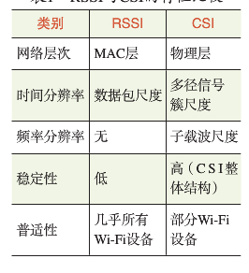
RELATED WORK
RSSI VS. CSI

Slide 10
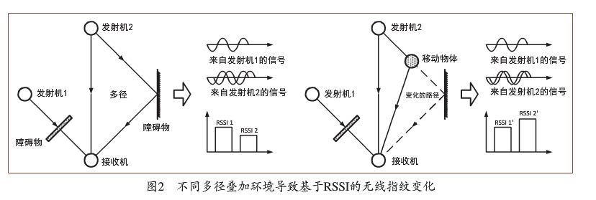
RELATED WORK
RSSI VS. CSI

Slide 11
04
Proposed method

Slide 12
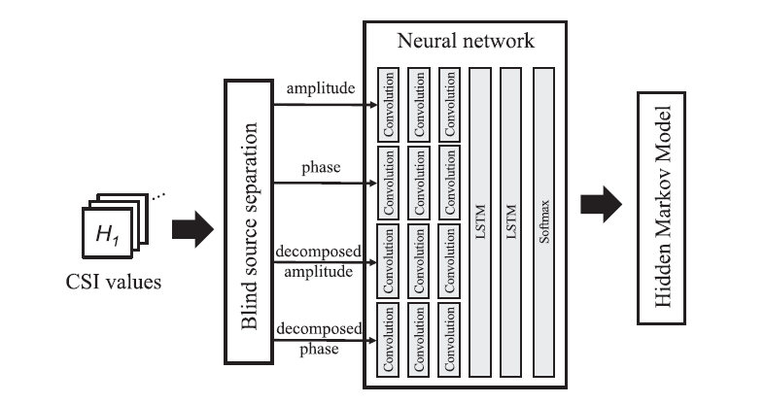
Proposed method

Slide 13
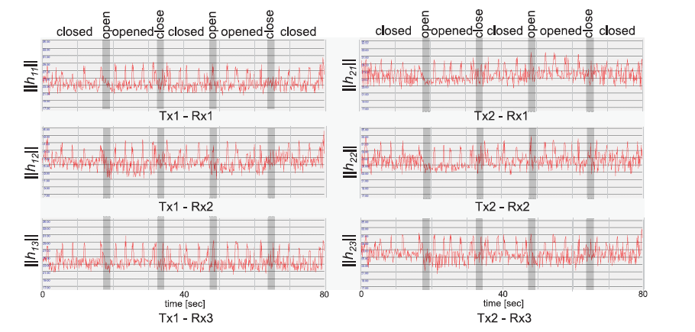
Proposed method
Blind source separation using ICA

Slide 14
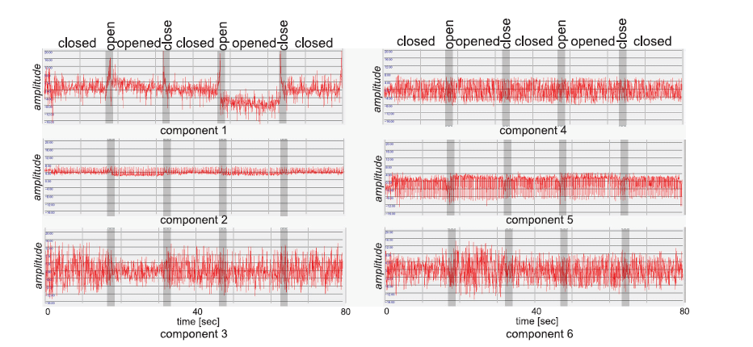
Proposed method
Blind source separation using ICA

Slide 15
Proposed method
Deep neural network

Slide 16
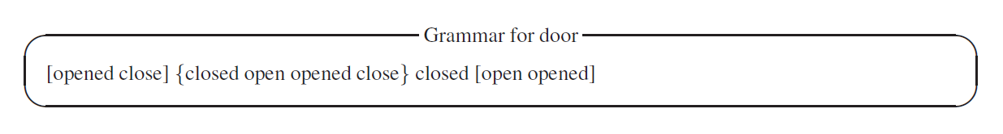
Proposed method
HMM decoding with grammar

Slide 17
05
Evaluation

Slide 18
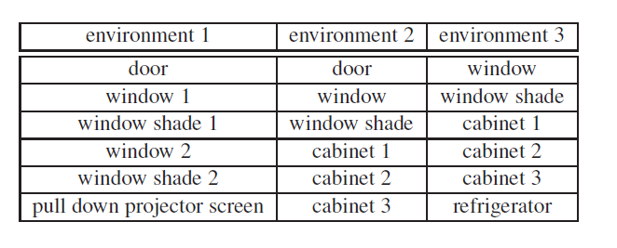
Evaluation
Data set: 90% train data, 10% test data

Slide 19
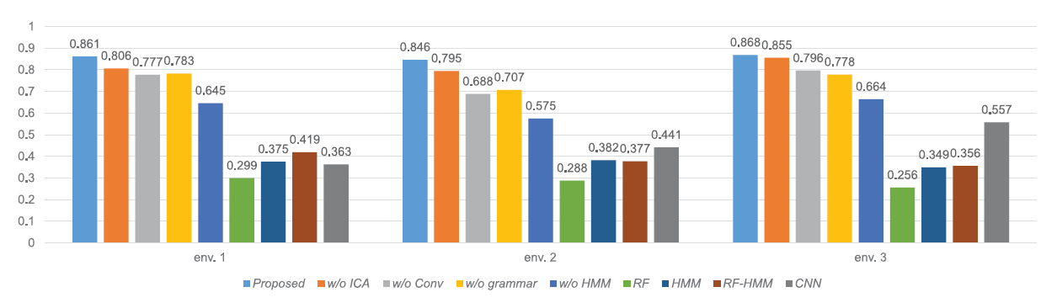
Evaluation
Result

Slide 20
06
Disscusion

Slide 21
Discussion
Effects of additional persons and objects
Effect of usage of objects
Evaluation with long-term data
Amount of training data
Effect of interference

Slide 22
Thank you
谢谢观看

